Slide 1
Welcome to Back-to-School Night!
Ms. Campos
English I/POR

Slide 2
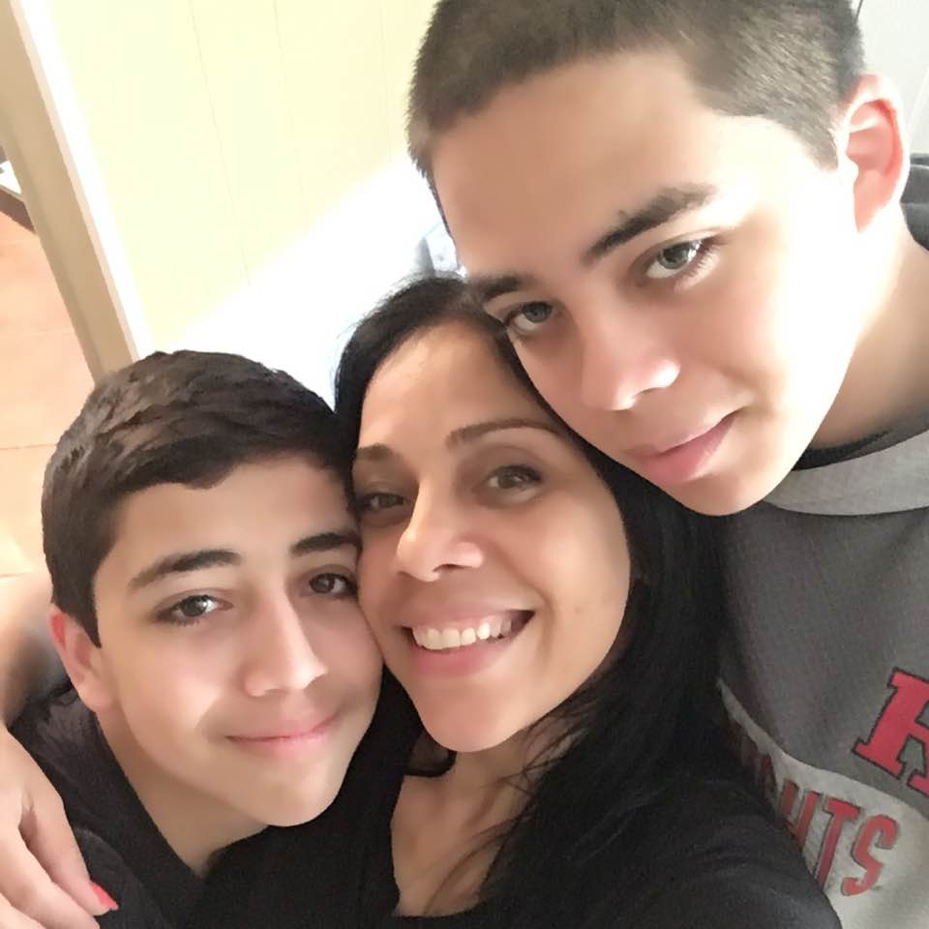
About Me
Sixth year teaching at Perth Amboy High School
Undergraduate degree: College of Saint Elizabeth
Working on my Master’s in Education from
Georgian Court University
Freelance writer
I am a mother to two teenage sons,
ages 17 and 19
I want your child to know that he/she can always
come to me with any concerns. I assure you that my classroom
is one where your child(ren) will feel safe, respected and valued.

Slide 3
Classroom Expectations
Stay positive
Respect yourselves
Respect classroom
Respect your peers
Respect your teacher

Slide 4
Academic Expectations
English 1 is a required course designed to introduce freshmen students to reading, writing, speaking, viewing, and listening. We will be reading complex literature, as well as a variety of informational text. By utilizing our new textbooks and technology, students will be encouraged to develop strong communication skills, build grammar, research, read and write for a purpose, as well as focus on academic vocabulary necessary for the rest of their education.

Slide 5
English I Curriculum
The Perth Amboy High School South Campus has adopted a brand new textbook (Collections-Houghton Mifflin Harcourt) that offers reading, writing, speaking, and listening skills that we are excited to share with your child(ren). This will be our 3rd year using Collections.
We will be reading a variety of novels, short stories, poetry, plays, and non-fiction text.

Slide 6
Classroom Policies
Students must report to class on time
Students should come to class prepared equipped
with a pen, books and notebooks. Binders will be provided!!
Homework is assigned 3-5 days a week and expected
to be handed in the next day
English classes are offered as blocked schedules, therefore,
they are two periods long. I allow students a short break
after the first part of the block

Slide 7
Special Projects
College class trip
Educational trip to New York State
Charity work and fundraisers (giving back)

Slide 8
Grading
Tests/ Quizzes/Essays/ Projects=60%
Classwork=35%
Practice (Homework)=5%
Class Motivation/Participation = will add to your final grade

Slide 9
Q&A
You are welcomed to ask any questions.
If you want additional information after today, you may
contact me via email or phone already provided on the
course syllabus sent home with your child and at the end
of this presentation.

Slide 10
The Learning Center
After-school tutoring for all students
3:10-5:10 M-TH
Extra help in all subject areas
Free Snacks
Rm. 1 – English/History
Rm. 4 – Physics
Rm. 5 – Math
Rm. 6 – Bilingual Math

Slide 11
Contact Information
For additional information you may contact me by calling
the school at 732-376-5471 or the guidance office.
You may also email me at diancampos@paps.net or visit my teacher web page by going to www.paps.net and clicking on teachers, scroll down and find my name

